Slide 1

CAR MARKET TRENDS ANALYSIS WITH CARDEKHO DATA
AICTE STU ID: STU6a6b6a25939401785424421
[ D A LOKENDRA REDDY ]

Slide 2

PROBLEM STATEMENT
The used-car market contains a large amount of data related to vehicle prices, age, mileage, fuel type, transmission and ownership.
It is difficult to understand how these factors influence the selling price without proper data analysis.
Therefore, this project aims to analyze CarDekho data and identify important car market trends and pricing patterns.

Slide 3
Project Description
This project analyzes used-car data from CarDekho using Python-based data analytics techniques.
The dataset is cleaned and explored to understand relationships between selling price and factors such as:Car year, price,Kilometres driven,Fuel type,Seller type etc.
Data visualization is used to identify market trends and generate meaningful insights.
CarDekho Dataset
↓
Data Cleaning
↓
Data Analysis
↓
Visualization
↓
Market Insights

Slide 4

WHO ARE THE END USERS?
Primary End Users
Used-car buyers
Car dealers
Car resale businesses
Market analysts
Vehicle sellers
Use of the project
Helps users understand used-car pricing patterns and make better buying, selling and pricing decisions.

Slide 5

Technology Used
Programming Language
Python
Libraries
Pandas
NumPy
Matplotlib
Seaborn
Dataset
CarDekho Used-Car Dataset
Python → Pandas → Analysis → Visualization

Slide 6
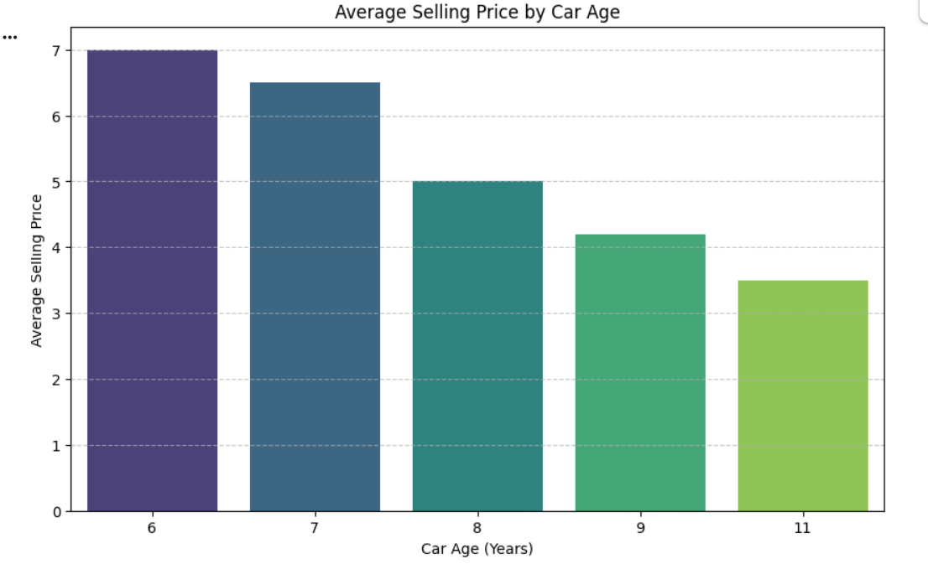
RESULTS
Car Age vs Selling Price
CODE GRAPH
import matplotlib.pyplot as plt
import seaborn as sns
avg_selling_price_by_age = df.groupby('Car_Age')['Selling_Price'].mean().reset_index()
plt.figure(figsize=(10, 6))
sns.barplot(x='Car_Age', y='Selling_Price', data=avg_selling_price_by_age, palette='viridis')
plt.title('Average Selling Price by Car Age')
plt.xlabel('Car Age (Years)')
plt.ylabel('Average Selling Price')
plt.grid(axis='y', linestyle='--', alpha=0.7)
plt.show()

Slide 7
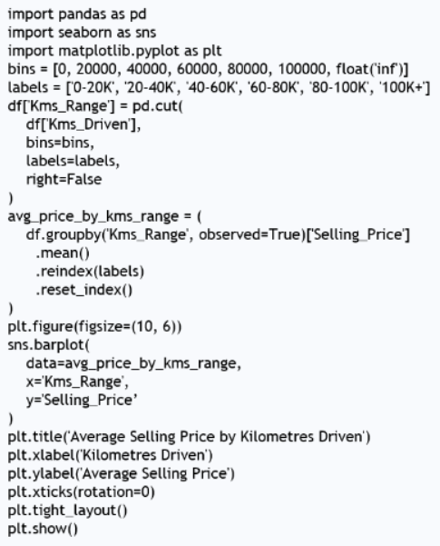
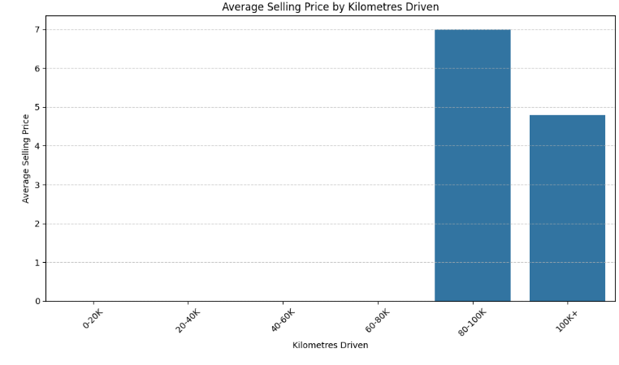
RESULTS
Kms Driven vs Selling Price.
CODE GRAPH

Slide 8
Thank you
.
.

